Slide 1

Library booking systEM
USW BOOKINGS
Team Three
Tamuka Mutasa Thuraya Almutairi
Ethan Harris Metin Kondo

Slide 2
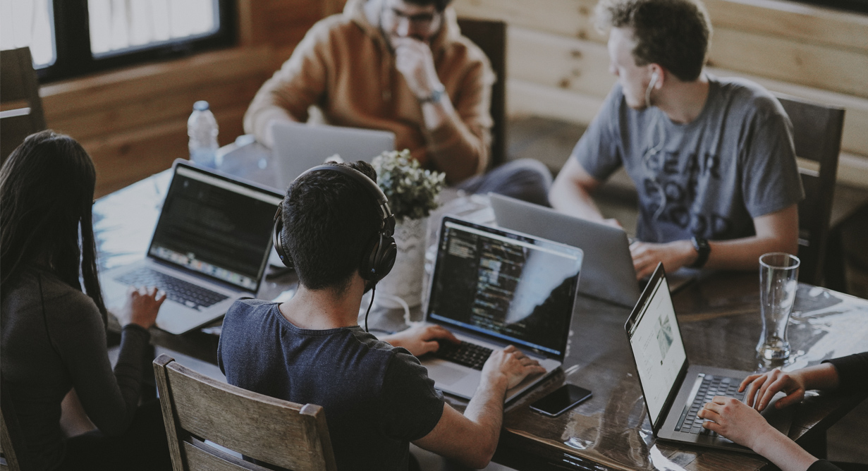
Team Roles
Tamuka Mutata
Team Leader
Thuraya Almutairi
Documentation Writer
Ethan Harris
Principal Developer
Metin Konde
Supporting Developer and Tester

Slide 3

Project Details
We are developing a library booking system
For management of library records
Removes the need for manual record keeping
Important for large libraries
Subscription based license model

Slide 4


Main features
Librarian can add or remove books/users
Members can see and checkout available books
Administration of fines for late return and lost books

Slide 5

Development approach
The software is being developed using agile development
This is an iterative approach to software development
GitHub is used to track the iterative changes and for collaboration
Trello is used for project management
Pair programming is used to ensure great code quality

Slide 6
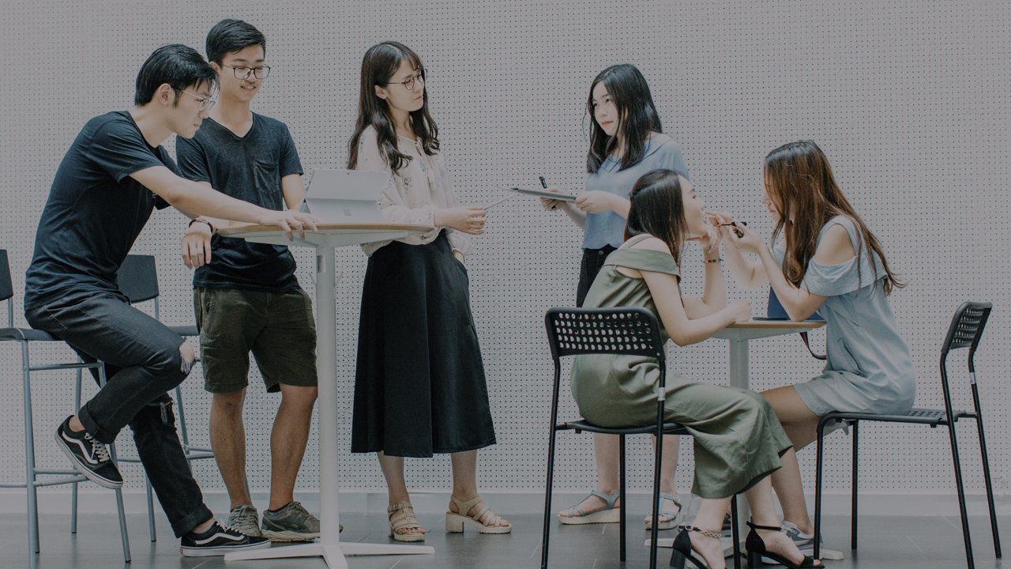
Development Approach (cont’d)
Unit testing are written to make sure each individual functions work well
On completion of the software, integration testing will be done
Finally, user acceptance testing will also be conducted
The documentation of the software will be written once the user acceptance testing is completed

Slide 7

Thank You!

Slide 8
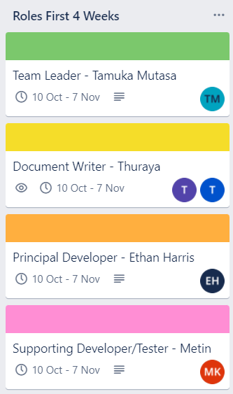
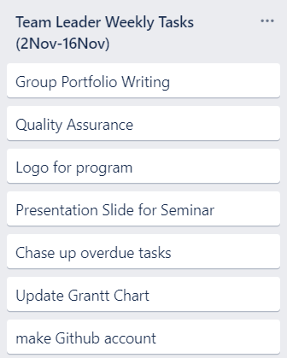
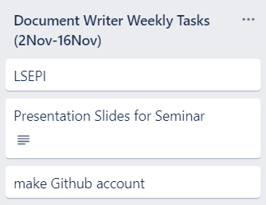
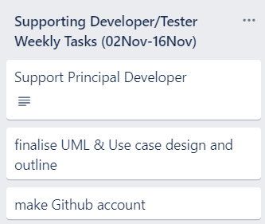
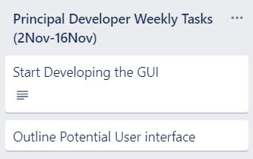
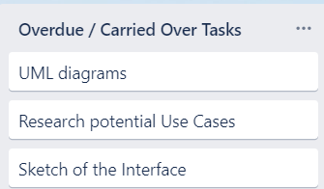
Trello Tasks

Slide 9
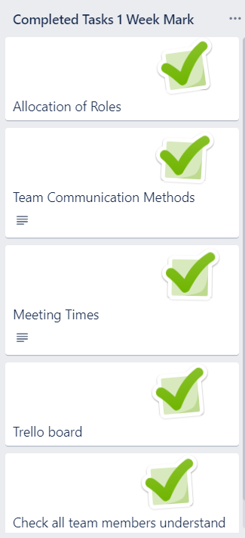
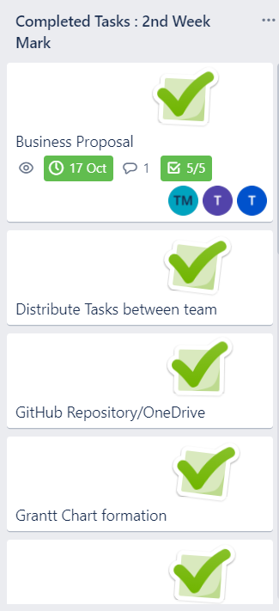
Trello Tasks

